Slide 1
Emotional Intelligence

Slide 2
Emotional Quotient
Objectives:
* Defining the concept of the Emotional Quotient.
* Know the model QE-i of Reuven Bar- On.
* Handle simple tools to represent the Emotional Quotient .
* Understanding the importance of the Emotional Quotient and its development in leadership.

Slide 3
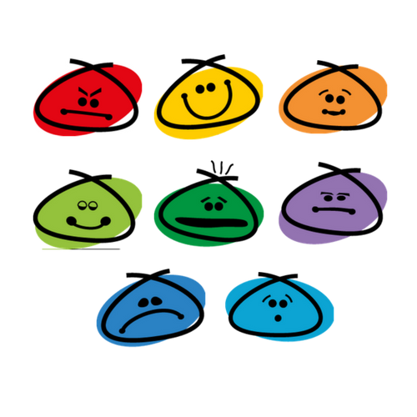
The Emotional Quotient It measures our capacity to understand and direct our emotions so that they work for us, which helps us to be more effective and to succeed in different areas of life. This model developed by Reuven Bar- On is based on five large key components, each of which includes three factors, creating a total of 15 scales or factors that can be measured with the psychometric tool that it has created, the EQ-i.

Slide 4
Emotional quotient (EQ-i)
Self -perception.
Self-expression.
Interpersonal Component.
Decision making.
Stress management.

Slide 5
Developing self-perception Self-Concept consists of respecting oneself while understanding and accepting one's strengths and weaknesses. Emotional Self-Awareness includes the recognition and understanding of our emotions, being aware of the impact they can have on our thoughts and actions. Self-Realization is the willingness to try to improve oneself voluntarily and to pursue meaningful and relevant goals.
Emotional Quotient (EQ-i)
Self -perception.
Self-expresión.
Interpersonal Component.
Decision making.
Stress management.

Slide 6
Developing self-expression Assertiveness involves the communication of feelings, beliefs and thoughts openly, as well as defending rights and values in a socially acceptable manner. Emotional expression is openly expressing feelings verbally or non-verbally. Independence is the attitude of not being emotionally dependent on others, it means behaving in a free and autonomous way.
Emotional Quotient (EQ-i)
Self -perception.
Self-expression.
Interpersonal Component.
Decision making.
Stress management.

Slide 7
Developing interpersonal component Empathy is recognizing, understanding and appreciating how others feel and behaving in a way that respects their feelings. Interpersonal relationships consist in developing and maintaining satisfactory relationships with others that are characterized by trust and compassion. Social responsibility is the willingness to contribute to society, certain social groups and in general, the welfare of others.
Emotional Quotient (EQ-i)
Self -perception.
Self-expression.
Interpersonal Component.
Decision making.
Stress management.

Slide 8
Developing decision making Problem solving is the ability to find solutions to problems in situations involving emotions, understanding how these influence decision-making. Contrast reality is the ability to remain objective and not let emotions alter our perception of things. Impulse control is the ability to resist or delay an impulse or the temptation to act, avoiding hasty decisions or behavior.
Emotional Quotient (EQ-i)
Self -perception.
Self-expression.
Interpersonal Component.
Decision making.
Stress management.

Slide 9
Developing stress management Flexibility involves the adaptation of emotions, thoughts and behaviors to unknown and unpredictable circumstances or ideas. Stress tolerance involves facing complex or difficult situations and believing that it is possible to manage and influence them. Optimism consists in maintaining a positive attitude and outlook on life, preserving hope despite occasional difficulties.
Emotional Quotient (EQ-i)
Self -perception.
Self-expression.
Interpersonal Component.
Decision making.
Stress management.

Slide 10
The Johari Window It is a psychological test that can help us to know in a graphic way our Emotional Quotient. The name comes from a play on words invented by the scientists Joseph Luft and Harry Ingham. They studied communication and its influence on interpersonal relationships, and as a result of their research they designed this test as a contribution to their theories.
Johari window
Free Area.
Negated Area .
Secret Area.
Hidden Area.

Slide 11
The free area of Johari's window It is the upper left rectangle, and its size indicates how much we show ourselves to people as we are. If that rectangle is big, it means that most of the time we are transparent, while if it is small, it means that we rarely say what we really think. It correlates with the "self-expression" component of the Reuven Bar- On model.
Free Area.

Slide 12
The negated area of Johari's window It is the upper right-hand rectangle, and its dimensions show us those aspects of our personality that we do not want to accept but that people around us can notice and even comment on. If that area is large it means that there are many aspects of that nature, and if it is small, it means the opposite. It correlates with the "Interpersonal" component of the Reuven Bar- On model.
Negated Area .

Slide 13
The secret area of Johari's window It represents all those things that we know about ourselves but don't want to show to anyone. If that rectangle is big it means that there are many things we do not share with the people around us, and if it is small it means that we have very few secrets from them. It correlates with the "Self-Perception" component of the Reuven Bar- On model.
Secret Area.

Slide 14
The hidden area of Johari's window It is the one whose dimensions reflect those aspects that people do not notice, and that even we ourselves do not manage to appreciate most of the time. If that rectangle is big it means that we are mysterious people who do not know ourselves very well. It correlates with the "Stress Management and Decision Making" components of the Reuven Bar- On model.
Hidden Area.

Slide 15
How do you take this test?
These are just two questions and quite straightforward, although answering them honestly and sincerely may not be an easy task at all.
Question 1: How much do I care what people say about me?
It is important to clarify that this refers to what people around you say or think but with whom you do not share in intimacy, i.e. family and partners are not taken into account here.

Slide 16
How do you take this test? Question 2: How much do I show others about me? It is important to clarify that here it refers to how transparent we are with those around us, that is, how sincere and honest we are when giving an opinion. Some people might want to change that question to one that can mean the same thing: Do we really say what we think?

Slide 17
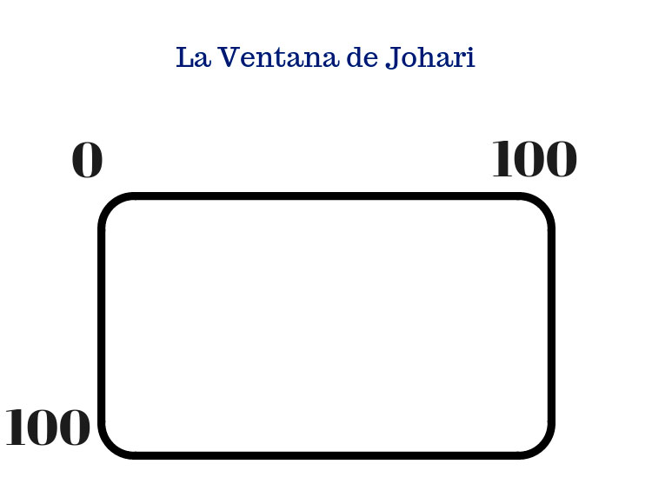
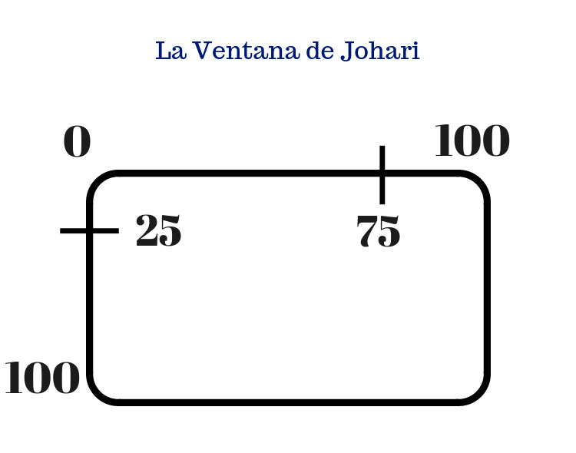
Your own Johari´s window As honestly as possible, you should answer, on a scale of zero (0) to one hundred (100), the first question. If you don't care at all, the answer is zero (0), but if you care obsessively, the answer is one hundred (100). If you never show them your emotions and never share your true way of thinking, the answer is zero (0) while if, on the contrary, you are extremely honest and always tell them what you think, the answer is one hundred (100).

Slide 18
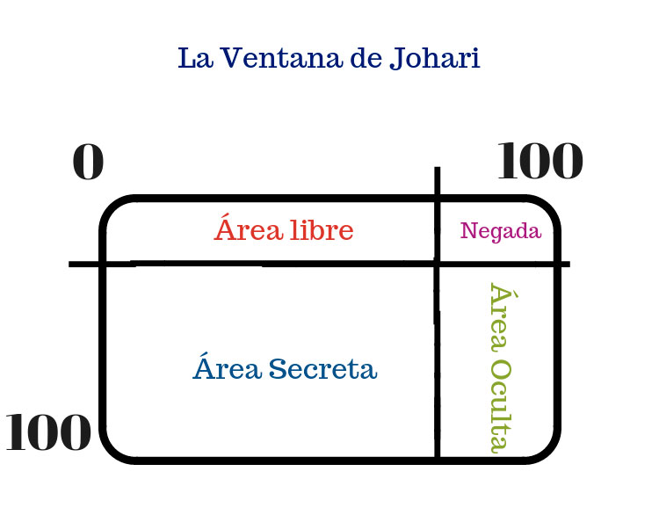
How to discover the 4 areas of the Johari window. Once you have answered the questions on a scale from 0 to 100, you must mark it in the rectangle and then draw lines to join the points as shown in the example. The Johari Window is only a reference sample, in this test there is no score that is considered as good or bad.

Slide 19
References : -Bar-On, R. (2006). The Bar-On model of emotional-social intelligence (ESI). Psicothema, 18(supl), 13-25. -Bar-On, R. (1997). BarOn Emotional Quotient Inventory: Technical manual. -Toronto: Multi-Health Systems. -Mayer, J.D., Salovey, P., Caruso, D.R. (2008). Emotional Intelligence: New ability or eclectic traits? American Psychologist, 63(6), 503-517. https://www.youtube.com/watch?v=pdUc6LJ8UoA&t=70s https://www.youtube.com/watch?v=LFTFkCS1eME

