Slide 1
EMOTIONAL INTELLIGENCE

Slide 2
Emotions and leadership
Objectives: * Define the importance and weight of emotions in the leadership process.
* Discover how to manage emotions and make them more profitable.
* Get to know the difference between emotion and emotional state, and learn how to keep the most operative one.
* Understand the relationship between emotions and decisions.

Slide 3
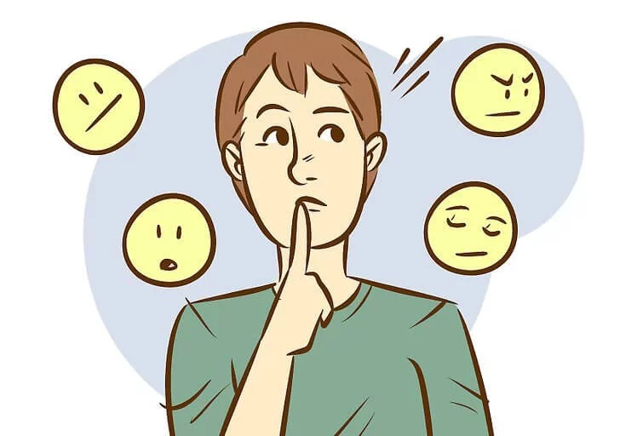
Emotions and leadership? - As any other human interaction, leadership implies a transference of emotions. - As sure as you are of your own emotion as a leader, you transfer it to others, and it impacts your results. - EI has to do with two big areas: intrapersonal (internal balance) and interpersonal (understanding and managing other people's emotions).

Slide 4
EMOTIONAL LEADERSHIP
INTRAPERSONAL AREA (ME)
INTERPERSONAL AREA (OTHERS)

Slide 5
The emotional cycle It explains the process why we experience emotions as reaction to certain stimuli, and how those emotions affect to our actions and, finally, to our results. Emotional Intelligence has to do with learning the management of the emotions, not avoiding or denying them, and always looking for the most operative result.

Slide 6
1. Stimulus Every day leaders are exposed to hundreds of circumstances, news or events which affect them and also their teams. Most times, those facts (with internal or external origin) are out of their influence but they are important for their daily performance and the proper functioning of the organization. Some of them are “positive” and some are “negative”.
STIMULUS

Slide 7
2. Meaning The stimulus, ‘the event that happens’, is important, but the real decisive factor is the meaning leaders give to it, that is, what story I tell myself about what is happening. Between the fact and the emotion is what Victor Frankl called “the freedom to choose”, because here lies our responsibility, and this is one of the main issues for leaders.
STIMULUS
MEANING

Slide 8
3. Emotion It is the specific reaction generated as an answer to a particular event, based on biochemical and physiological alterations in our body and nervous system. They happen as an internal answer, but with external connotations and reflects. Emotions are not good or bad, they are just signals which need to be understood and managed as reactions towards external inputs.
STIMULUS
MEANING
EMOTION

Slide 9
4. Action The sum of all those external reflections are our actions, that is, all what leaders do and also what they do not do. Action comes from ‘act’ and, the way we act defines our attitude towards life. Action is what people can see about us, but the real interesting fact is that our attitude comes from a certain emotion which is transferred to others showing a kind of balanced or gut leadership.
STIMULUS
ACTION
MEANING
EMOTION

Slide 10
5. Result The consequence of our actions are our results, in any way and in any aspect. We use to explain our life in terms of our results, but we do not use to think about their origin and motivation. Even, in this cycle, they use to reinforce the initial stimulus, becoming themselves in new stimuli which start again the wheel and explain themselves a kind of leadership.
STIMULUS
ACTION
RESULT
MEANING
EMOTION

Slide 11
If after this cycle, our result is not the expected or desired one, here is the point where Emotional Intelligence works. EI acts just in the space previous to a new contact or encounter with the stimulus which generated a non operating emotion. The stimulus will be again the same, unalterable, and if we keep giving the same meaning we will be prisioners in a wheel without arguments to change our results.
STIMULUS
ACTION
RESULT
MEANING
EMOTION

Slide 12
Emotions Vs Emotional state Emotions are punctual, so they are a key factor to explain our results, but only in a short-mid term. Long-term results are explained by the emotion we are able to keep for a longer time, and here the most important factor is not the external stimulus or the meaning we gave to it, but what we do to sustain that emotion in time. Here is the responsibility or a leader ir order to make balanced decisions. .
TIME
INTERPRETATION
EMOTIONAL STATE

Slide 13
Emotions are human, punctual and very short answers to external circumstances. But when we add to that original emotion: - TIME: How long do we keep it? - INTERPRETATION: Long term meaning to an original stimulus. Then we are generating an emotional state, and this can explain long-term and even all-life results.
TIME
INTERPRETATION
EMOTIONAL STATE

Slide 14
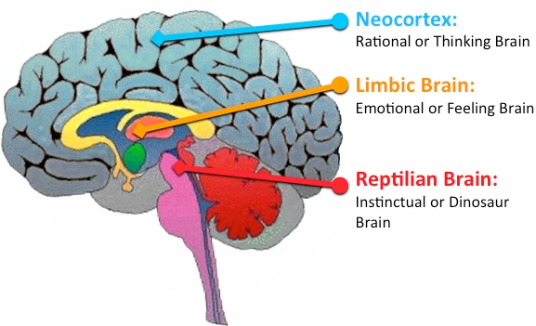
Emotions and decisions The theory of the triune brain is a model of the evolution of the vertebrate forebrain and behaviour. It consist of three zones: - The reptilian complex (animal brain) - The limbic system (emotional brain) - The neocortex (rational brain) Most human decisions are emotional and non-rational, so it is a challenge for a leader in stressful situations.

Slide 15
Rational or emotional? Under normal circumstances, humans process information through our neocortex or “thinking brain” where logic occurs. On occasion, there is a short circuit whereby this is bypassed and signals are sent straight to the “emotional brain”. When this happens, leaders have an immediate emotional response disproportionate to the original event, making non-rational decisions. This is called ‘emotional hijack’

Slide 16
Balanced decisions In order to avoid permanent and non-operational emotional decisions, leaders need to develop self-awareness and impulse control, generating balanced decisions based on long-term analysis and perspective. Against instinctive reactions, leaders must learn to create rational responses, calming the first impulse and analyzing all the aspects from a rational point of view.

Slide 17
Decisions sustained over time Leaders take balanced decisions sustaind in time and aligned with the strategic plan when they are built over operational emotional states. They do it giving coherence to any emotion, sustaining it in time and in the same way in three dimensions: thoughts (mindset), actions (behaviour) and words (language).
THINK
DO
SAY

Slide 18
The three pillars Emotional states, and thus operational, long-term and inspiring leadership, is based in three aspects:
LANGUAGE
Gratitude, recognition, statement… (operational)
Criticism, complaint, judgment (non-operational)
PHISONOMY
Corporeality, non-verbal communication.
Smile, confidence, rapport…
FOCUS
Goals, mission, vision, values and company culture.
Rentability. People and result orientation.

Slide 19
References: - Goleman, D. (1995) Emotional Intelligence. Bantam Books. - McLean, P. (1990) The triune brain in evolution. Plenum. - Ledoux, J. (1998) The Emotional Brain: The Mysterious Underpinnings of Emotional Life. Simon and Schuster. - George, J. (2000). Emotions and leadership: The role of emotional intelligence. SAGE Publications. - https://www.youtube.com/watch?v=jEMPyjATNC0 - https://www.youtube.com/watch?v=zAjWi663kXc - https://www.youtube.com/watch?v=8yxgPFXWLJA - https://exploringyourmind.com/amygdala-hijack/

