Slide 1
FEEDBACK

Slide 2
Cognitive biases and the impact in
quality feedback

Slide 3
Objectives of the Module
Learn how to give effective feedback
How to improve the performance of others using feedback
Mistakes when giving feedback
Feedback from leadership

Slide 4
Objectives of the PowerPoint
What is a cognitive bias? .
Types of cognitive biases
The main biases and their impact on feddback
Cognitive bias mitigation
Mitigating strategies

Slide 5
What is a bias and where does it come from?
A cognitive bias is the psychological effect of a deviation in mental processing, leading to distortion, inaccurate judgment or illogical interpretation, which occurs on the basis of interpretation of the available information.
unconscious biases can become a major obstacle to feedback

Slide 6
Biases are often categorized based on the aspect of people’s judgment and decision-making that they affect, as well as their reason for doing so. Based on this criterion, the main types of biases are often the following:
Types of cognitive biases
Calculation biases
These affect the way in which we calculate things such as probabilities or values
Information biases
These affect the way in which we acquire and process information
Belief biases
These affect the way in which we form and modify our beliefs
Memory biases
These are biases that affect the way our memory works
Social biases
These are biases that affect our social perception and behavior

Slide 7
The main biases and their impact on feedback
As we all know, there are many cognitive biases that influence our actions & behavior. look at a few that could influence Feedback
Anchoring
Bias
Halo
Effect
Confirmation
Bias
Group Bias
or Affinity
Central
tendency
bias
Negativity
bias

Slide 8
It is a cognitive bias that causes our impression of someone in one area to influence our opinion of that person in other areas. This bias can cause us to assume that a person is highly knowledgeable and has an interesting personality, simply because they are physically attractive.
Halo effect
The halo effect at work occurs for example when managers have too positive a view of a particular employee. This can affect the objectivity of reviews as managers give them high marks and fail to recognize areas for improvement

Slide 9
We have a natural tendency to try to confirm our preconceived beliefs, whether positive or negative, about people in the way we interpret or remember their performance, which is known as confirmatory bias.
Confirmation Bias
For example, a manager may have a prior idea that his men's team is more assertive. This might make it easier for him to remember events where his statement was correct. On the other hand, they may perceive that their female team is less assertive, predisposing them to forget when they suggested an effective strategy or if they succeeded in a difficult negotiation.

Slide 10
People are influenced by the information that is already available or that is displayed first. Another effect of anchoring is that we can address new problems by applying the decisions we have made on similar problems in the past. This bias is very significant in creative problem solving where it can limit open thinking, since we are using reference points created at the beginning
Anchoring Bias

Slide 11
Group Bias or
affinity
There is a tendency to favour those who are part of our group or are like us, whether they are from the same ethnic, cultural, professional or educational background. When making decisions, for example, it is likely that you will have certain pre-formulated opinions about someone who is part of your group or is like you, and it is likely that these opinions will condition your decision, even if it is unconscious and therefore may influence your feedback.

Slide 12
People have a natural bias towards negative situations. This is a natural defense mechanism that helps us remember and avoid dangerous situations. However, the negativity bias can also hinder our professional development. Instead of learning from constructive feedback, it can induce fear or anger.
Negativity bias

Slide 13
Central tendency bias
This bias affect performance evaluations. Whenever a 5 or 3 point scale is used, evaluators tend to group most of their collaborators in the middle. When managers have an underperforming employee and simply dare not give them a low score for fear of damaging the employee's confidence. This is worse for employees as it does not make them aware of the fact that they need to improve and does not give them information about where they should focus.

Slide 14
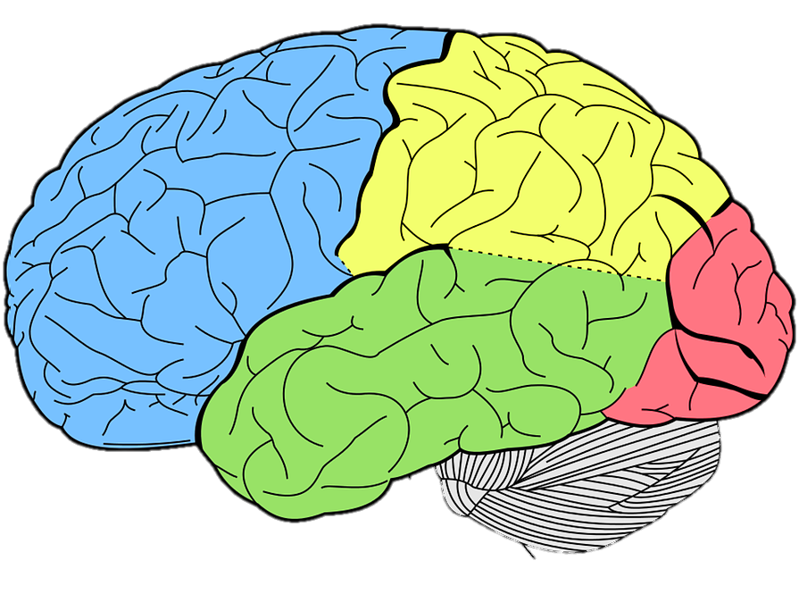
Cognitive bias mitigation
Debiasing (which is also referred to as cognitive bias mitigation), is the process through which we reduce the influence that cognitive biases have on people, in order to enable them to think in a more rational and optimal manner.
We can become aware of our own biases and apply strategies to counteract their automatic interference in our professional and private lives

Slide 15
Stages in the mitigation process
First, a cognitive bias is triggered.
Then, you must become aware of this bias, and realize that it has been triggered.
Once you realize that the bias has been triggered, you must choose to debias.
If you do choose to debias, you need to start by assessing the bias, which involves determining in what way the bias affects you.
Once you understand what you’re dealing with, you need to select the appropriate mitigating technique and apply it.
Once you have successfully debiased, you can now move on to make an optimal decision.

Slide 16
Mitigating strategies
General mitigation strategies ,which can help you deal with the majority of cognitive biases
Change incentives
Develop awareness of cognitive biases
Increase involvement in the decision-making process
Improve the way you present information
Increase personal accountability
Favor simple explanations over complex ones
Elicit feedback from others
Slow down the reasoning process
Standardize the decision-making process
Use nudges
Create favorable conditions for decision making

Slide 17
Mitigating strategies
In some cases, simply being aware of a certain bias can help you reduce its impact.
The same information, presented in two different ways to the same person, can lead to two very different outcomes. By modifying the way you present information to people, you can reduce the influence of certain cognitive biases
When it comes to mitigating biasing, using simple explanations is generally preferable to using complex ones. People who encounter a complex explanation to reject it in favor of a simpler alternative.

Slide 18
Mitigating strategies
By forcing yourself to slow down and think through the information that you are trying to process. That it allows you to reflect on your reasoning process, and to think through alternative viewpoints, while also encouraging you to avoid relying on biased intuitions.
Changing people’s incentives can help mitigate the cognitive biases that they experience. There are two parameters;
1.You can increase the benefits of making a non-biased decision. That is, by rewarding non-biased thinking in some way,
2.You can increase the penalties for making a biased decision

Slide 19
Mitigating strategies
Increasing how involved people feel about a certain decision and how much they care about it can reduce certain cognitive biases
When they will be held accountable for their decisions , they tend to put more effort into the decision-making process, which can sometimes help people mitigate certain cognitive biases
Receiving feedback from other people can help reduce certain cognitive biases. This is the case of biases that influence people’s perception of themselves, such as the worse-than-average effect, which causes people to incorrectly believe that they are worse than other people at performing certain difficult tasks

Slide 20
References
https://www.psychologytoday.com/intl/blog/thoughts-thinking/201809/12-common-biases-affect-how-we-make-everyday-decisions
https://www.verywellmind.com/what-is-a-cognitive-bias-2794963
http://mentalfloss.com/article/68705/20-cognitive-biases-affect-your-decisions
https://www.autentia.com/wp-content/uploads/2020/01/012-SESGOS-COGNITIVOS.pdf

