Slide 1
DECISION MAKING

Slide 2
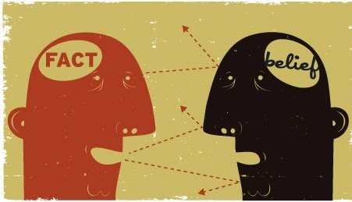
Barriers and biases in decision making
Objectives:
Raise awareness about barriers in decision making.
Recognize cognitive biases that influence thinking and decision making.
Show how to overcom biases in order to make better decisions.
Understand why it matters.

Slide 3
Barriers in Decision making process
Decision making is a cognitive activity, the result of thinking that may be either rational or irrational.
Individual characteristics including personality and experience influence decision-making.
An individual’s predispositions can either be an obstacle or an enabler to the decision-making process.
Leaders should be aware of barriers and try to overcome them as much as possible.

Slide 4
Bounded Rationality in decision-making
Complete rationality is unattainable because:
the list of the potential consequences of each option is long → no complete information;
the possibilities of different outcomes are usually unknown and can only be estimated → rational choice is not possible;
decision-makers do not always behave compliantly with the principle of maximizing.
Nonrational decision-making is common, especially with nonprogrammed decisions.

Slide 5
Time Pressure as a Barrier to Decision Making
Time pressure can distort decision-making processes and individual judgment and make them less objective and more influenced by intuition.
Decision-makers often simplify decision-making, relying on the application of heuristics.
Time pressure may also have the opposite effect in terms of creating organizational motivation to render decisions and move on.
Heuristic or mental shortcuts →method of problem solving that makes assumptions based on past experiences.
Time pressure acts as a deadline and encourages organizational dexterity.

Slide 6
Biases in decision-making
Biases in how we think can be major obstacles in any decision-making process.
Biases distort objective decision-making by introducing influences that are separate from the decision itself.
We are usually unaware of them.
Biases in decision making
Framing bias
Overconfidence bias
Confirmation bias
Representative bias
Anchoring bias
Availability bias
Sunk cost bias

Slide 7
Overconfidence bias
Decision-makers overestimate their ability to make good decisions.
Overconfidence means overestimation of favorable against unfavorable outcomes without observing and without an analysis.
Decision-makers either do not notice the dangers or ignore them.
Characteristics
Apply rational approach to the prediction and evaluation of the probabilities of events.
Reconsider the justification of one’s personal assumptions and estimation.
Reconsider the established cause and effect relations resulting from decisionmakers’ too high self-confidence.
How to overcome it

Slide 8
Framing bias
Cognitive bias where people are forced to decide based on the way the information is presented.
In the problem identification phase observe the problem from different perspectives.
If the message is framed positive - reframe it negatively. If it is framed as a gain, reframe it as a loss.
In the final phase decision makers should return to the problem identification phase and change the perspective of observation in order to generate new options.
Reframe the problem from different reference points.
Reframe the problem in the reversal direction.

Slide 9
Availability bias
I have all the truth!
Decision-making is dependent on the decision-maker’s memory.
Determine the probability of events on the basis of an objective analysis of the relevant data, regardless of the decision-maker’s experience.
It is necessary to give less importance to the already collected information.
Things happening in the world
Things I know

Slide 10
Representative bias
A decision maker wrongly compares two situations because of a perceived similarity.
Examine the causal connection between conditional events.
Determine conditional probabilities on the basis of an objective assessment, not on the basis of a subjective conclusion.

Slide 11
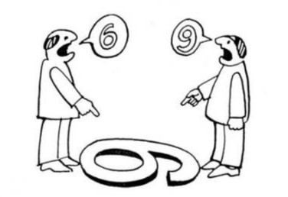
Confirmation bias
Represents the gathering of information that
supports one’s initial conclusions.
Check whether all of the alternatives
are assessed on the basis of the same criteria.
Examine the arguments supportive of the suggested alternative and also encourage a critical view of the choice of the best alternative.

Slide 12
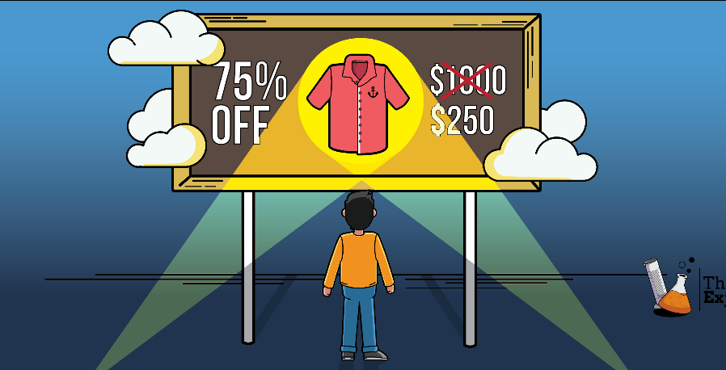
Anchoring bias
the overreliance on an initial single piece of information or experience
the tendency to fix on the initial information and the failure to adjust for subsequent information as it’s collected.
Apply alternative approaches in the problem solving process.
Be open to new ideas and suggestions that may affect change in the initial state.

Slide 13
Sunk cost bias
Decision-makers are trying to justify the outcome of earlier bad decisions made by the new choices – favoring the choice that supports the decisions made earlier in the past.
The culture that causes the fear of failure and leads to the fact that decision-makers do not want to admit their mistakes should be discouraged.
Engage individuals who have not been involved in making previous decisions.

Slide 14
Conflicts as decision-making barrier
Sometimes the best decision involves some conflict.
While conflict can be uncomfortable it is necessary for the group, department, or organization to function effectively in the long run.
Process conflict → task-oriented and constructive and not focused on the individuals involved.
Relationship conflict → personal and involves attacks on a person rather than an idea.
emotional intelligence and empathy are important
explore options together
Keep feedback focused on behaviors and activities (how things are done) rather than on the individual.

Slide 15
Groups and decision-making process
In cohesive groups common values help focus decisions around shared goals.
Encouraging constructive disagreements and even conflict can result in more-creative ideas or more solutions that are easier to implement.
Decisions made by groups can be better informed by broader perspectives and different sources of information and expertise than those made by an individual decision maker.
Interpersonal and group dynamics presents dilemmas that can make it more difficult for groups to make effective choices.

Slide 16
Groupthink
Leaders should not express an opinion when assigning a task to a group.
Leaders should absent themselves from many of the group meetings to avoid excessively influencing the outcome.
The organization should set up several independent groups working on the same problem.
All effective alternatives should be examined.
Each member should discuss the group’s ideas with trusted people outside of the group.
The group should invite outside experts into meetings.
At least one group member should be assigned the role of devil’s advocate.
One of the greatest inhibitors of effective group decision making.
The desire for harmony or conformity results in an irrational or dysfunctional decision-making outcome.

Slide 17
Uncertainty
Leaders frequently make decisions under conditions of uncertainty.
The leader making the decision will ultimately have to choose one option and see what happens, without knowing what the results would have been with the alternate option.
Uncertainty makes it difficult for some leaders to make decisions, because committing to one option means forgoing other options.

Slide 18
Reducing biases
Spot the biases
Start with a clean slate
Challenge the status quo
Seek multiple perspectives
Search for more information & data
Play Devil’s Advocate
Reflect on your own views & values
AVOID BIAS
NEXT EXIT

Slide 19
References
Freedom Learning Group. Barriers to Decision Making. https://courses.lumenlearning.com/boundless-management/chapter/barriers-to-decision-making/ Lumen Learning.
Freedom Learning Group. Biases in Decision Making. https://courses.lumenlearning.com/wm-organizationalbehavior/chapter/biases-in-decision-making/ Lumen Learning.
OpenStax. Principles of Management. https://opentextbc.ca/principlesofmanagementopenstax/chapter/barriers-to-effective-decision-making/
Nikolić, Jelena: Biases in the decision-making process and Possibilities of overcoming them. Economic Horizons, January - April 2018, Volume 20, Number 1, 43 – 57.

