Slide 1
MANAGER TRANSITION

Slide 2
Delegation Style Objectives of the Module
Learn the main methods and tools for delegation
Recognize priorities and delegable activities
when
who
what
how

Slide 3
To get rid of activities that can be carried out by others, the first thing to do is to check the times used for very important, strategic, unimportant activities and the time that is dedicated to each and what is their value.
when

Slide 4
Delegating means assigning tasks and related responsibilities to other people, giving them the tools they need to perform them, demanding that they respond to the results achieved. There are two types of delegation

Slide 5
Delegation with Control
Assign to others the realization of a task-assignment by defining times and ways for example: attendance recording, data entry in the company management defining methods and times for insertion, control and verification before sending the payslips ...
Delegation with responsabiity Assign responsibility for achieving results to others
- Complex activities
- Strong result orientation
- Independence
It involves longer times, is more effective over time

Slide 6
People to whom to delegate responsibilities and tasks must possess technical, relational and behavioral characteristics and skills.
who

Slide 7
To those who show the will to learn and grow
To those who show enthusiasm and motivation
Which proves to be the most competent and prepared (not always ..)
To whom to delegate
To whom it assumes its responsibilities
To those who can question themselves
For those who know how to withstand pressure and stressful situations

Slide 8
Those who delegate must evaluate which competences the delegate possesses, which competences must be implemented and acquired and the suitable tools to enhance the missing competences

Slide 9
The effectiveness of the delegation also depends on the maturity and motivation of the manager's collaborators.
According to David McClelland's theory of the need for motivation (1961):
Individuals who aim to make a career (high performers) prefer to receive proxies on even poorly structured activities, but with very specific objectives and responsibilities, so that the feedback on their performance is measurable and well defined.

Slide 10
Individuals with lower job aspirations (low performers) prefer a greater level of detail on how to perform each individual task. Generally, according to the latter type of collaborators, it is easier to achieve positive results when the standards are specific.

Slide 11
 | LOW PERFORMANCE: basse aspirazioni lavorative | HIGH PERFORMANCE: aspirazioni di carriera
Type of delegation | delegates with a high level of detail on the task | even poorly structured proxy with indication of the objectives to be achieved
Objectives of the delegation | Entrust simple achievement goals and responsibilities to increase self-confidence. | Entrust ambitious and challenging goals and responsibilities
Attitude of people | fear of losing your job due to bankruptcy They focus on sanctions and criticisms associated with bankruptcy They prefer ambiguity in order not to clearly define responsibilities | great self-confidence and ability They focus on the rewards and satisfactions of success. They prefer clarity in responsibilities
Relationship between efficacy of delegation and people

Slide 12
There are activities that can be delegated as:
Routine activities
Activities that require special knowledge
Preparatory activities
Responsibility on project phases
and others that do not lend themselves to delegation
what

Slide 13
The delegation process
Analisis
Goal definition
Guidelines
Monitoring
Check results
how

Slide 14
ANALYSIS: identify the tasks and areas that can be delegated and identify delegates paying attention to existing workloads
OBJECTIVES DEFINITION: to share objectives clearly and precisely through group or individual meetings
GUIDELINES: to establish the delegate's autonomy boundaries to reduce / eliminate areas of uncertainty, assess risks and financial-technical-organizational resources

Slide 15
MONITORING: establish evaluation criteria, deadlines, progress, analysis and reports. The delegator follows the process to encourage and support the delegate
VERIFICATION OF RESULTS: verification of the results and consequences / impacts of the achievement or failure to achieve the objectives

Slide 16
DELEGATION STYLE | ADVANTAGES
CENTRALIZATION | O Each decision is made by a single manager
REPORT | The delegator is constantly informed
TALKS | A real delegation is not implemented even if the relationship is more direct and informal
OPEN -DOOR | Maximum availability of the delegator
NET | Situation controlled under IT / management aspects (shared knowledge management systems)
TEAM MEETINGS | Frequent group / team meetings are organized
DELEGATION STYLES

Slide 17
STYLES OF DELEGATION: advantages and disadvantages
DELEGATION STYLE | ADVANTAGES | DISADVANTAGES
CENTRALIZATION | total control | culture of distrust and non-growth of the delegate
REPORT | the delegate is committed to reporting on his work constantly | low motivation of the delegate
TALKS | the delegator always has climate control | runs the risk of being emotionally involved
OPEN -DOOR | Delegates feel supported | delegates feel protected / supported and find it hard to take the initiative
NET | the delegator can check in real time the progress of the activities / projects | it has a partial and inaccurate vision, it is sufficient only on available computer data
TEAM MEETINGS | greater sense of team | individual responsibility is mitigated

Slide 18
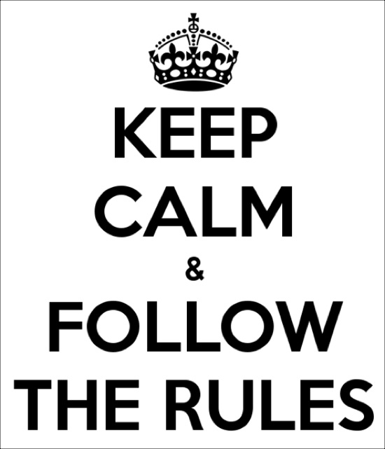
The Good Rules
schedule periodic but not too frequent meetings
delegate at least 80% of ineffective activities
support delegates
do not solve problems for the delegate
progressively thin the matches
ask for and provide feedback
pay attention to communication
believe in delegation as a process
always remember to celebrate success

Slide 19
Bibliography
-Peter Drucker: “Management by objectives, la guida per obiettivi, e la missione etica del manager.» The Practice of management ( 1954)
-Peter F. Drucker -Le sfide di management del XXI secolo -2016
-Teoria sul bisogno di motivazioni di David McClelland (1961):
-Stephen R. Covey -Le sette regole per avere successo, Franco Angeli 2016
-Brian Tracy-Delegare e Coordinare- la biblioteca del successo- Gribaudi Edizioni 2015

