Slide 1
COACHING

Slide 2
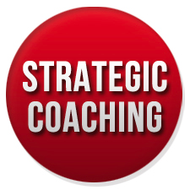
STRATEGIC COACHING

Slide 3
What’s Professional Coaching?
Coaching is a form of development in which an experienced person, called “the coach”, supports a learner or client in achieving a specific personal or professional goal by providing training and guidance.

Slide 4
A general classification differentiates these types of coaching Individual Coaching and Group/Organisation Coaching
Types of Professional Coaching
Individual Coaching | Groups / Organisation Coaching
Career Coaching | Executive Coaching
Life Coaching | Strategic Coaching
Personal Coaching | Systemic Coaching

Slide 5
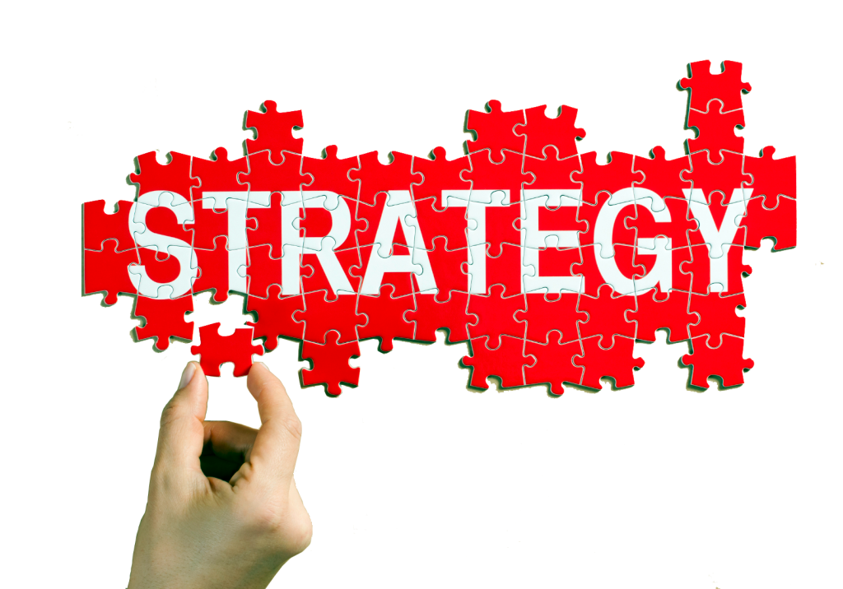
What’s Strategic Coaching It is an integrated approach to coaching and executive development. It aligns the development needs of the coachee to the strategic needs of the organization. The coachee develop and improve performance directly linked to organisation strategy that eventually cascades down to the entire organisation

Slide 6
Goal The goal of strategic coaching is to increase individual performance in the context of a common business strategy. To be effective, executive coaching must be both strategic and individualized:

Slide 7
Executive needs + Strategic needs To engage and motivate individuals, executive coaching must be tailored to their needs and aspirations. To deliver business results, the coaching must also be tailored to the strategy, vision, and values of the organization.

Slide 8
What makes a strategic coaching successful?
Strategic
Systematic
Company Effort
Tailored
Aligned to Company Goals
Analitic
Effective Feedback
Notes:
Esta se podria reducir y poner fotos

Slide 9
Helps developing of high-impact future leaders and retaining them Identification of strategic leadership competencies It is higly motivating for the coachee as it covers personal tailored development that will empower their development. Drives other important business positive results thanks to a more effective leadership
Benefits of Strategic Coaching

Slide 10
Planning: Outline strategic business plan, break it down into action steps, and plan the coaching process. Executive Selection: Assess eligibility, orient executives to the program, and determine matching characteristics. Coach Sourcing: Identify internal or external coaches, assess qualifications, determine matching characteristics, orient to the program, and contract with the organization 6 and the program.
Phases of a Strategic Coaching Program (1)
Notes:
Esta tb se podría modificar

Slide 11
Matching Match coaches to executives, conduct initial meetings, and determine acceptability of the matches. Coaching Engagement Review assessment data, create development plans, monitor coaching sessions, and conduct periodic program meetings. Evaluation Assess effectives, participant reactions, ROI, etc. of individual engagements and overall program. This data helps in developing the planning phase of the next program cycle.
Phases of a Strategic Coaching Program (2)
Notes:
Esta tb se podría modificar

Slide 12
The Strategic Coaching Process
Framework
Contracting Coach
Comprenhensive Assesment
Action Planning
Active Learning
Feedback

Slide 13
Where executive coaching becomes strategic is in the preparation that precedes the actual coaching process.
Framework for the Process
What are the key business challenges facing your organization today? In the next two to five years?
What business goals are you trying to achieve?
What core values best define a common framework for how business results are achieved in your organization?

Slide 14
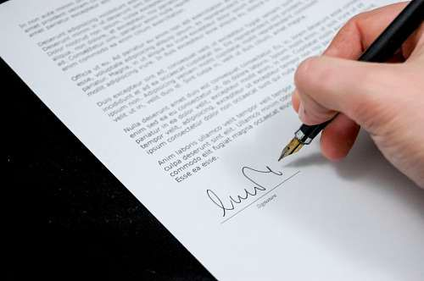
Sample of a Coaching Contract
Careful Contracting the Coach
Attendees should typically include:
Senior-level human resource
The executive coach
The executive receiving the coaching.

Slide 15
The goal is to identify coaching needs in the business context Face-to-face interviews with key stakeholders, such as direct reports, peers, bosses, and customers, and by shadowing the executive during his/her daily work Feedback gathered is both quantitative and qualitative
Comprehensive Assessment

Slide 16
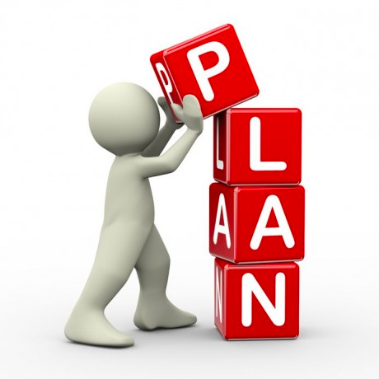
Action Plan
Identification of strengths and their contribution to the goal
Development Areas
Suggestions for active learning or experiential development
A process to follow-up with stakeholders
Key milestones

Slide 17
Feedback
Overview
Stages
Agree on targets and review ground rules
Preparing executives for feedback and flow process,
Constant referring to the framework of business
Establish rapport
Review coaching objectives
Review results with executive
Discuss surprises or frustrations
Highlight strengths
Identify development needs
Agree on areas of improvement

Slide 18
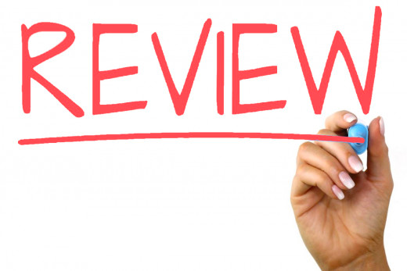
Approximately six months after the feedback session Evaluation of the impact of the process in the individual Identify areas where improvement is still needed and introduce midcourse corrections Follow-up is a critical factor in the success of the entire coaching process. Additionally, to ensure overall quality, assessment of the coach is essential.
Reviewing

Slide 19
International Association of Coaching https://certifiedcoach.org/ Talent in Motion https://tim-coaching.com/ Payperthink. http://www.payperthink.es/
References

