Slide 1
COACHING

Slide 2
SYSTEMIC COACHING
What is systemic coaching? What characterizes systemic coaching? What are the principles of systemic coaching? Systemic laws

Slide 3
SYSTEMIC COACHING
COACHING
SYSTEMIC
It is the art of questioning
It will not give advice on action
It will not make any judgement
It serves the system as a whole
It operates with systemic laws

Slide 4
EFFECTS
It allows solving doubts, difficulties and problems by becoming aware of the situation and seeing its possible evolution
Visually represents the interconnections of the system and their effects
By seeing unconscious images in perspective, the person manages to understand the dynamics that generate conflict
Make conscious
Make concious
Visualize
Understand
Understand

Slide 5
WHAT IS A SYSTEM?
Emotional
Set of elements related to each other functionally, so that each element of the system is a function of some other element, there being no isolated element.
Professional
Spiritual
Parents
Finantial
Conjugal
Intellectual
There are interrelationships
There are Interdependencies
There is Exchange
Children
Service
Health
Social

Slide 6
Characteristics of the systems
We live in systems and we are continuously going in and out of them.
Systems have their laws.
They act whether we know their laws or not.
If we know them, we can be more effective when entering, interacting and leaving systems.
Any action by us or by others affects others.
We belong to a multitude of systems simultaneously.

Slide 7
Characteristics of the systems (continued)
A system is a set of interconnected elements.
Each element fulfills its function for the rest of the system.
The fact that we do not know what that function is, in us or in others, does not invalidate their interaction.
They tend to seek balance (homeostasis).
Each part supports a tension to contribute to balance.
If an element is weak, it must be strengthened.
Balance is necessary for your permanence.

Slide 8
The person cannot be an isolated element
All people belong to a certain system that directly or indirectly conditions their way of being and their beliefs about life.

Slide 9
The person loses prominence in favour of the system
In the face of conflict, you should always look for the best solution for the system and not what is best for one or more people in that system. In this way, it will be a more beneficial solution for everyone and also more durable.

Slide 10
Any modification or action of a member affects the entire system
Remember… Everyone belongs to a certain system that directly or indirectly conditions their way of being and their beliefs about life.

Slide 11
The person belongs not only to a system, but to a network of systems
Each of us belongs to several systems: personal, business, family, etc. This fact can cause problems in the company when, for example, a member agrees to do something in the organizational system that conflicts with what they have to do in their family system.

Slide 12
There are systemic laws that help systems grow and evolve
Every company or system is based on systemic laws that must be known.
When these laws are not kept in mind, the reactions and decisions taken when faced with different events can negatively affect the company as a whole and each individual's own personal system.

Slide 13
Systemic laws
1st Law of Belonging
2nd Law of Prevalence or Antiquity
3rd Law of Balance
4th Law of Hierarchy
5th Law of Recognition
6th Law of Acceptance

Slide 14
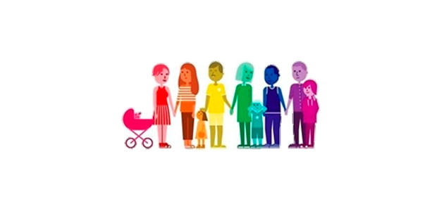
Law of Belonging
The link exists as long as the link with the company is maintained
The link is permanent
Every member has the right to belong to the system and NO ONE has the right to exclude them.

Slide 15
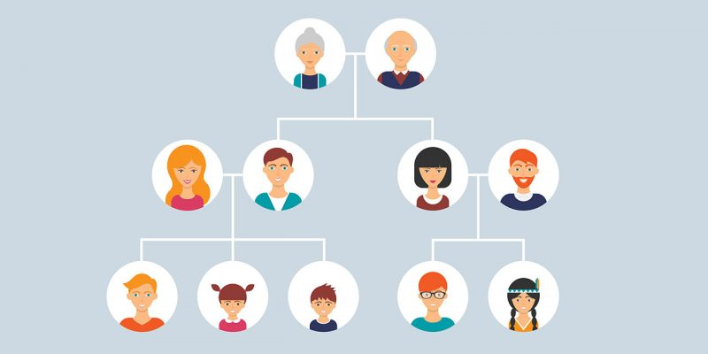
Law of Prevalence or Antiquity
Input to a specific system. Whoever has come before has a right over the one who comes later.
At family level is permanent
At business is equal to hierarchy
What happens when order is not respected? Why does this happen?

Slide 16
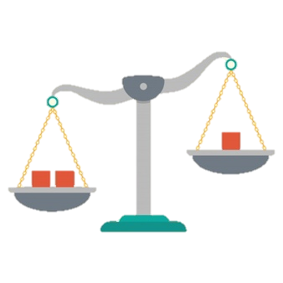
Law of Balance
In giving and receiving.
If there is no balance the system breaks down. Give more and more and less and less.
What happens if I ask and I don't give?
What happens if I give and don't ask?
What happens if I ask and I don't give?
What happens if I give and don't ask?

Slide 17
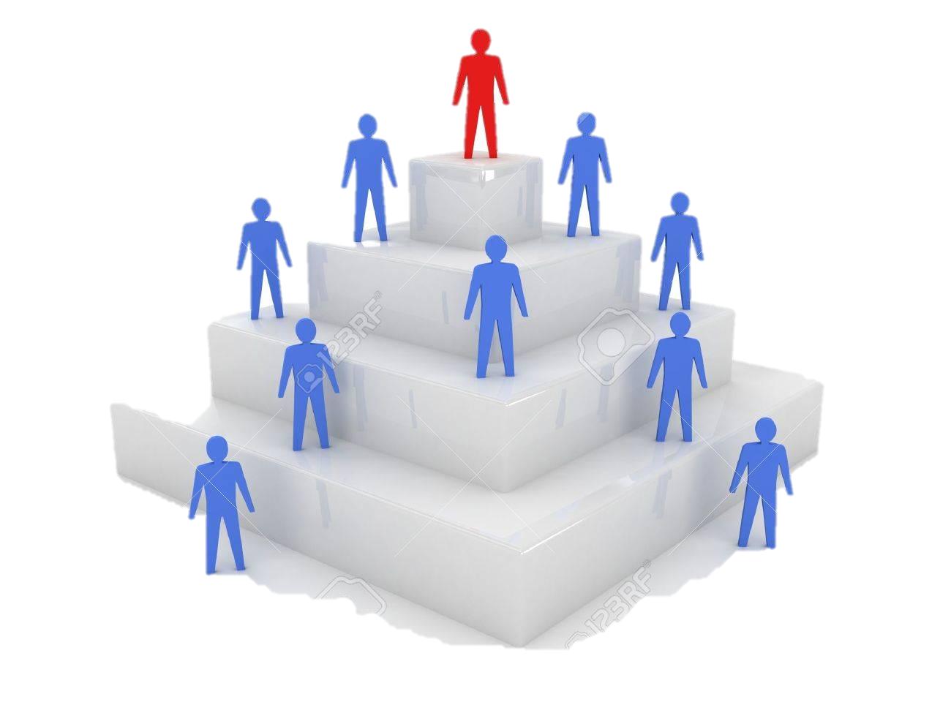
Law of Hierarchy
Management has priority.
Those who reach a position of hierarchy are at the service of others.
We are not all the same.
What happens when you bypass someone, you allow them to bypass you or when they bypass you?

Slide 18
Law of Recognition
It is directly linked to personal self-esteem since the level of belonging of a worker increases the moment they receive fair recognition.
In this context, great dissatisfaction can occur on a personal level in the absence of emotional caresses.
What is the importance of each area depending on the subsistence of your company?
Can you order them now?

Slide 19
Law of Acceptance
The best way to position ourselves in our working reality is to understand and accept what is the philosophy of the organization of which we are part:
What are the rules that govern it?
What are the staff like?
Do you accept and recognize what happensis in your organization?
Do you know how to move from this point?

Slide 20
BIBLIOGRAPHY
Peter M. Senge “The Fifth Discipline”
Ludwig von Bertalanffy “General System Theory”

